Slide 1
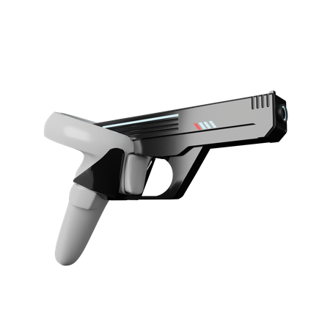
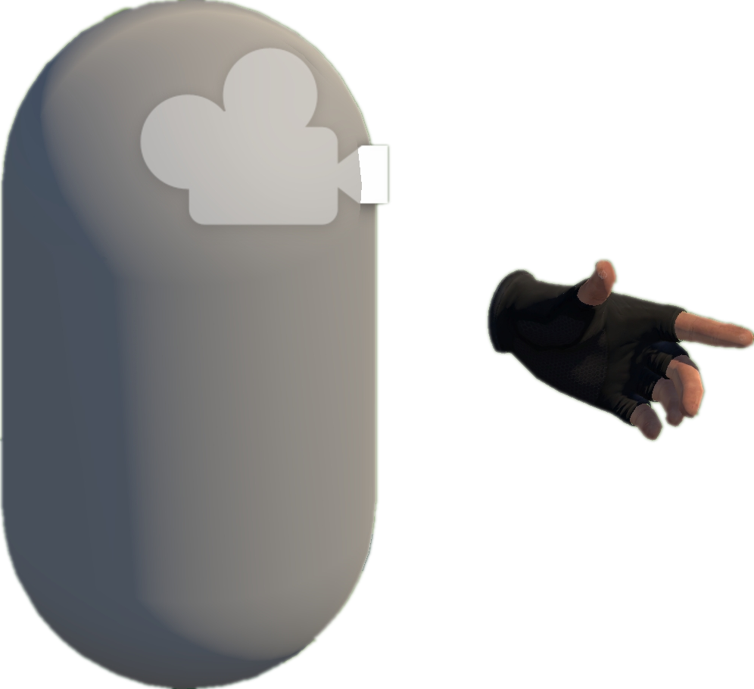
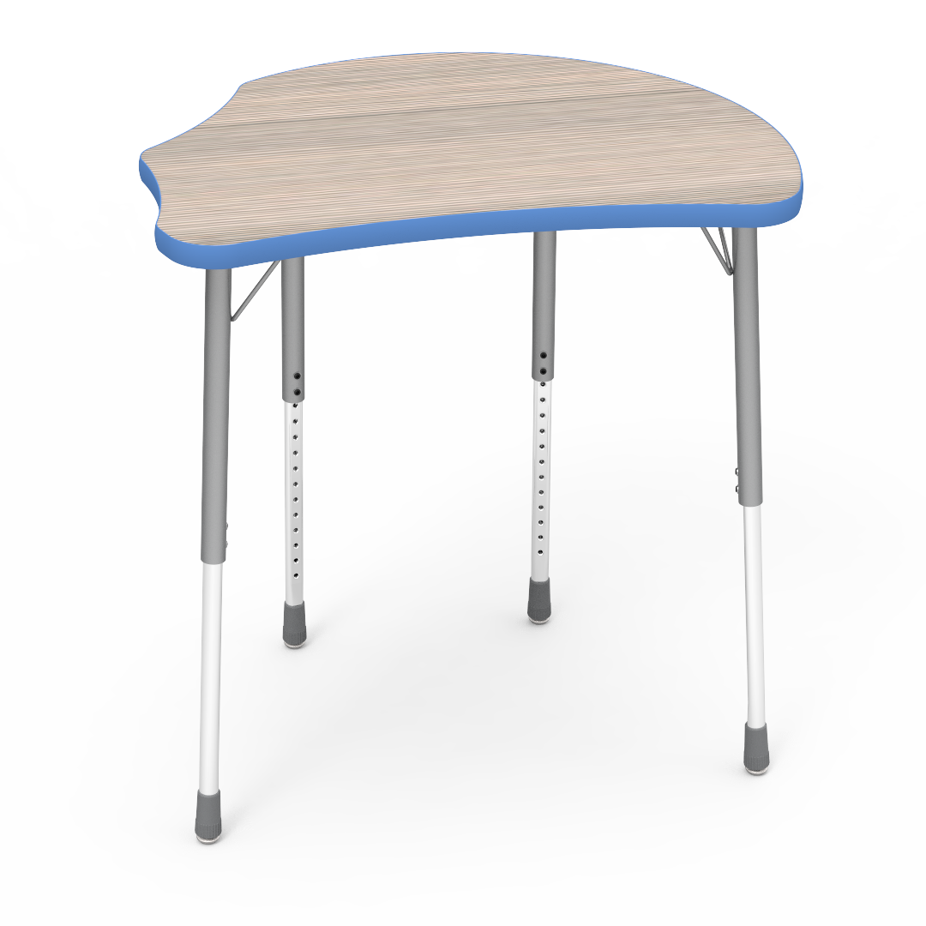
Move to Approcach The Gun
Grab-And-Shoot-Gun Task
1
Parallel Action
Move Action
Grab Action
Try to Grab the Gun
2
Move Action
Move Action
Trigger Action
Trigger
Action
Trigger
Action
Move Around Randomly;
Try to Fire the Gun
3
Asynchronous Action

